Slide 1

HW2 – Q7
Alireza Abbasi

Slide 2
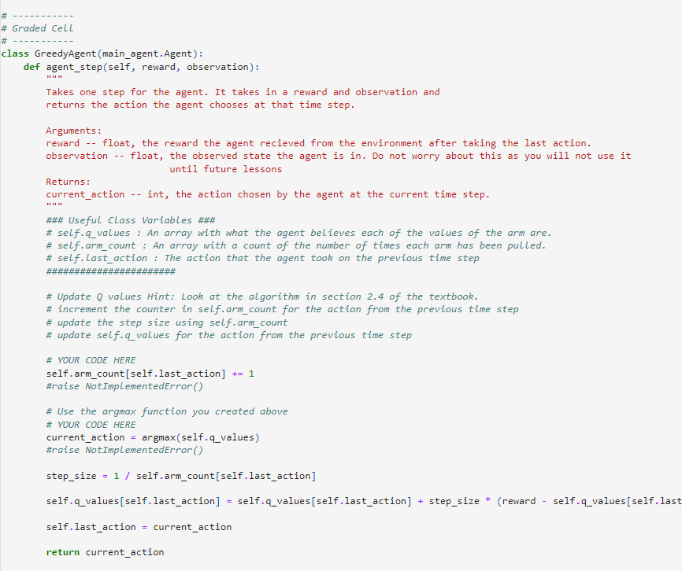
Greedy Agent

Slide 3
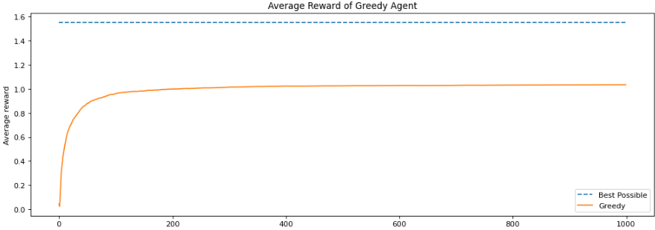
Greedy Agent Result
This testbed is based on Sutton textbook. So the desired value is about 1.55 .
But the greedy method sets the best value at 1 approximately.
In the greedy method, we expect a higher rate of reward in the first steps. But converging the reward to a sub-optimal value

Slide 4
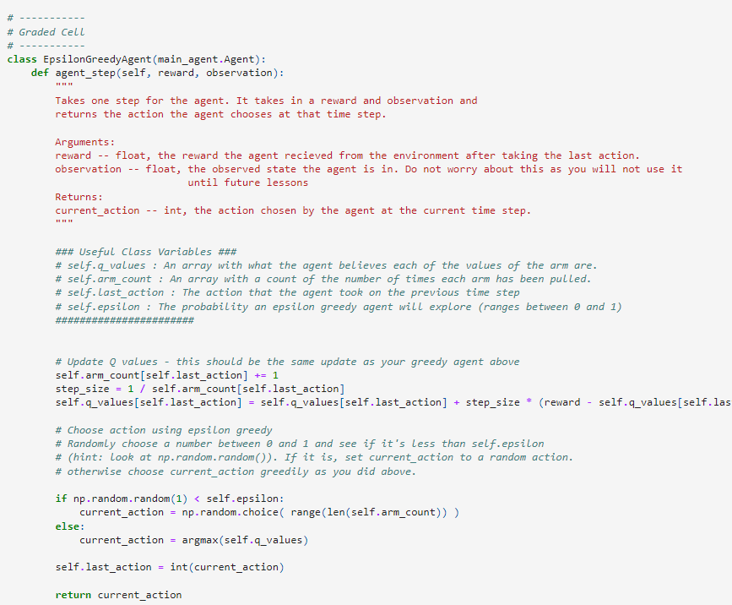
Epsilon Greedy Agent

Slide 5
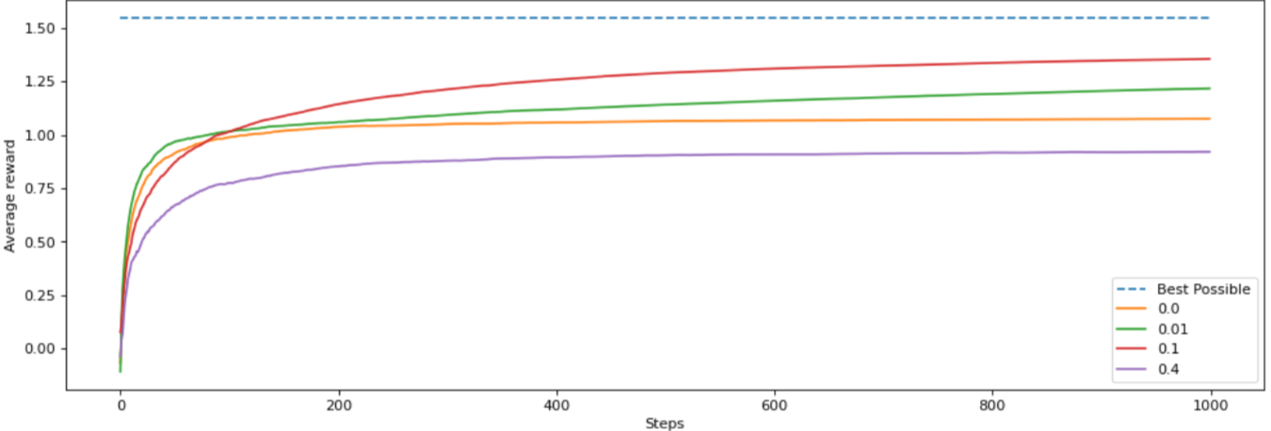
Epsilon-Greedy Agent Result
The epsilon-greedy method, with e = 0.1 , does better than the greedy method in every steady state.
It shows that there exists an optimal epsilon which results in a fast response.
But the convergence value is not optimal, and it has not yet reached 1.55 as seen in the chart.

Slide 6
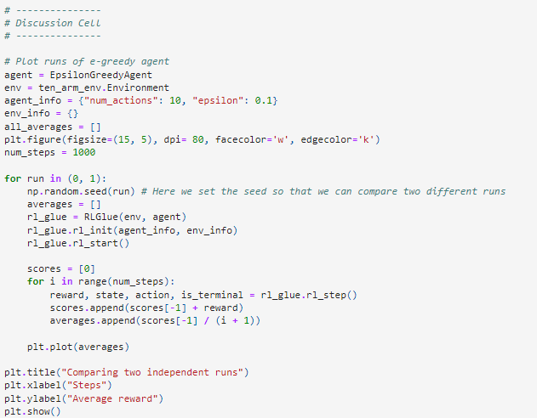
Averaging multiple runs

Slide 7
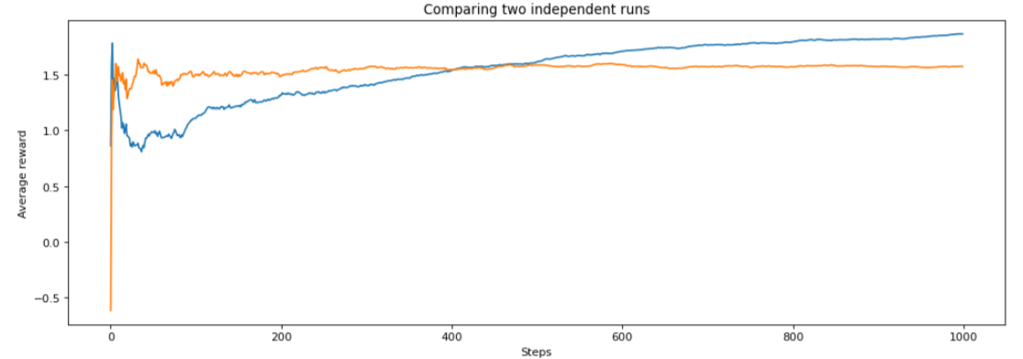
Averaging multiple runs

Slide 8
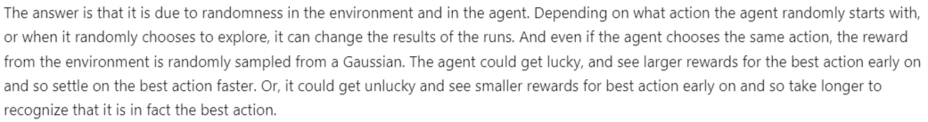
Why despite same agent and envs, results are different?

Slide 9
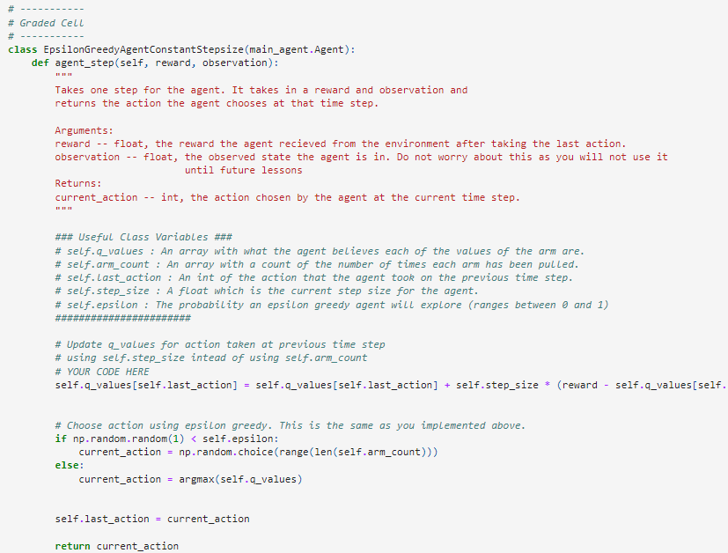
Epsilon-Greedy Agent Constant Step size

Slide 10
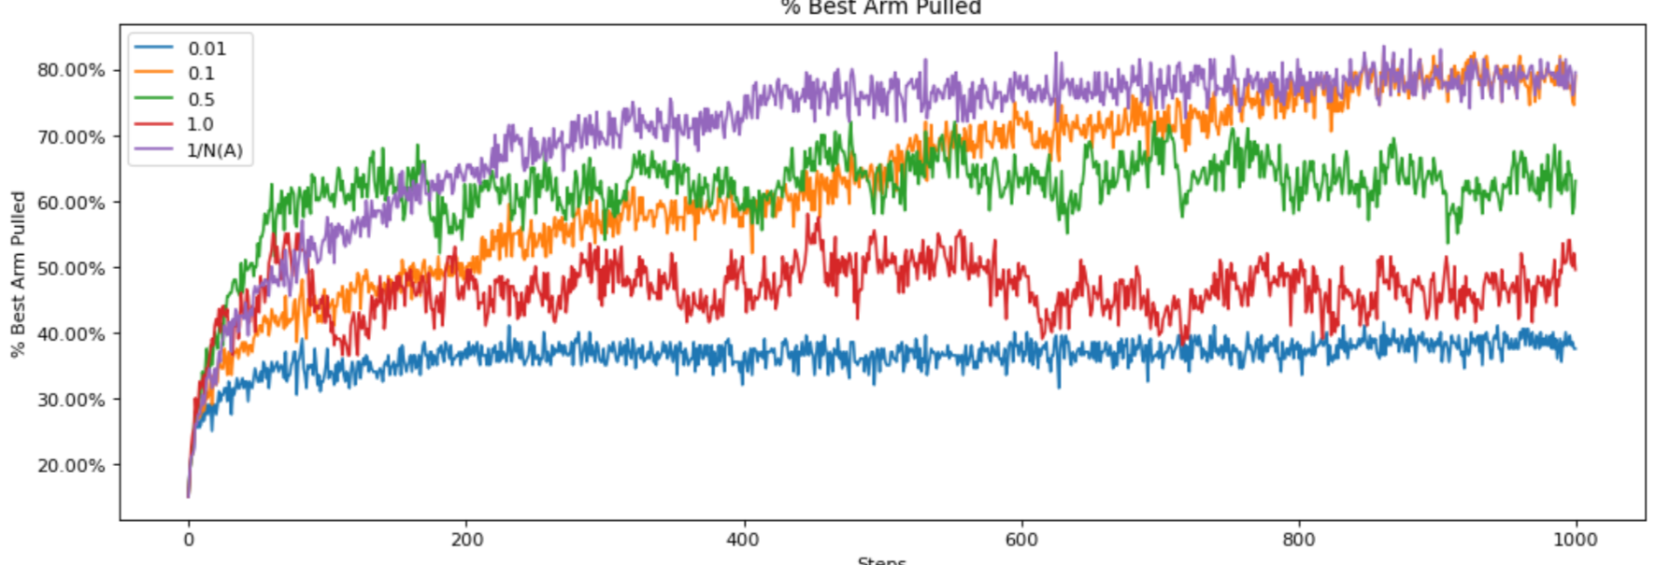
Epsilon-Greedy Agent Constant Step size result
As seen in the chart, in steady state the constant step of 0.1, and normal epsilon greedy methods are doing good.
In the first steps, in e = 0,5 & e = 1, the results are better due to more greedy policy.

Slide 11
UCB Agent
UCB agent due to more exploration in the first steps (until the exploration factor becomes less dominant) has a weaker result. But in the long term it tends to act better.
In UCB method, the exploration becomes less after taking steps. So it does better than epsilon-greedy method which choses randomly between sub optimal actions.

